Slide 1
Representing types in hardware

Slide 2
Basic units of information
Name | Size | Usage | Notes
Bit ביט = סיבית | 1 | Stores 1 or 0 | Minimal unit of information
Nibble חצי בייט | 4 Bit | A unit of information | Out of use
Byte/Char בייט | 8 Bit | A unit of information, at most chars | The minimal unit of information with address
Word מילה | 8 Byte (=64 Bit) | Numbers (integers, fractions), pointers | A size of a word depends on the machine

Slide 3
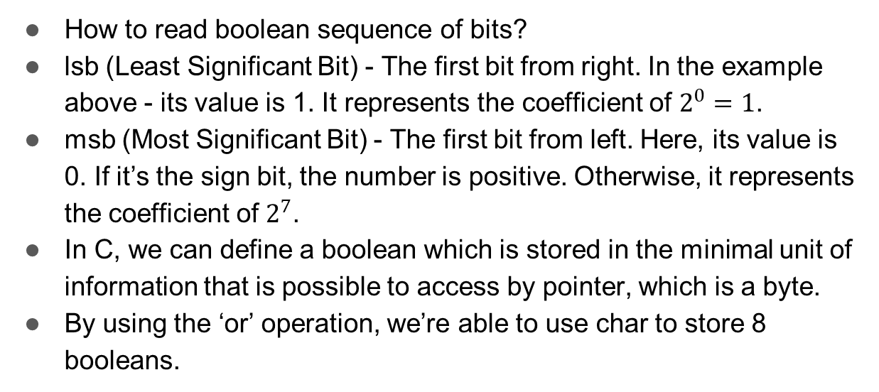
Reading the information
MSB
LSB
0 | 0 | 1 | 0 | 0 | 0 | 0 | 1
How to read boolean sequence of bits?
lsb (Least Significant Bit) - The first bit from right. In the example above - its value is 1. It represents the coefficient of $2^{0}=1$.
msb (Most Significant Bit) - The first bit from left. Here, its value is 0. If it’s the sign bit, the number is positive. Otherwise, it represents the coefficient of $2^{7}$.
In C, we can define a boolean which is stored in the minimal unit of information that is possible to access by pointer, which is a byte.
By using the ‘or’ operation, we’re able to use char to store 8 booleans.

Slide 4
Big/Little Endian
Assume we want to save the following number in our memory:
10000000 10001101 00000100 00000001
Big Endians
00 | 10000000
01 | 10001101
02 | 00000100
03 | 00000001
Little Endians
00 | 00000001
01 | 00000100
02 | 10001101
03 | 10000000

Slide 5
Computer Organization and Assembly

Slide 6
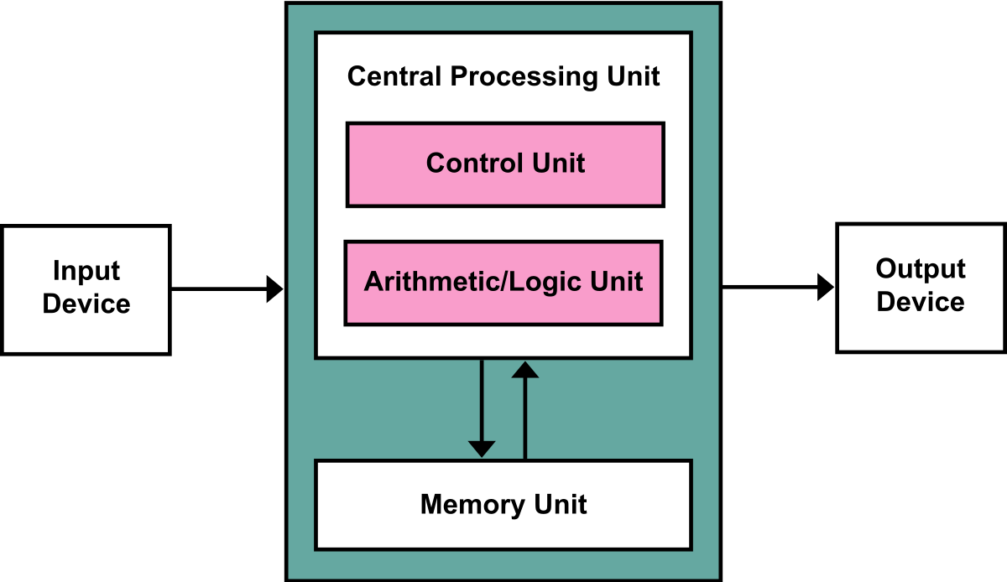
Computer Organization
Almost all computer are based on the same basic design
Von Neumann Architecture
Four main subsystems
Memory
CU
ALU
I/O

Slide 7
Computer Organization - Cont.
CPU reads/writes to/from Memory
Both data and instructions
Instructions are executed sequentially
CPU also interacts with devices
Usually through controller
Appears as memory buffer to cpu
Gives meaning to computations

Slide 8
The CPU
As stated, the CPU consists of two main parts: CU, ALU.
ALU
Performs mathematical/logical operations
Uses data from registers - small storage units utilized by the cpu
CU
Does memory fetching and storing
Decodes Instructions, and executes them

Slide 9
Machine Language
There are many different CPU producers on the market
Any many different architectures
Each different architecture behaves differently
different amount of registers (and register sizes)
different instructions
In particular, different opcodes
I.e: encoding
https://shell-storm.org/online/Online-Assembler-and-Disassembler/

Slide 10
Assembly
Low level programming language, corresponding with some ISA
Every machine instruction has a matching mnemonic
Architecture specific
Supports more than just defining a sequence of instructions
Comments, labels, memory locations
Compilation is done using an Assembler
One architecture can have many different assembler, with different syntaxes
E.g: x86 has both AT&T and Intel syntaxes commonly used

Slide 11
x86-64
1978, Intel released their 8086 CPU, where the x86 architecture was first seen
16-bit, CISC
Chosen by IBM to be the CPU of their first PC, it gained popularity fast
Years later, at 2003, amd released their amd64 architecture
Superset of x86, basically a 64 bit version
Also known as x86-64
Commonly used all around the world, we’ll be focusing on it.
Also, at least for now, we’ll be using AT&T syntax.

Slide 12
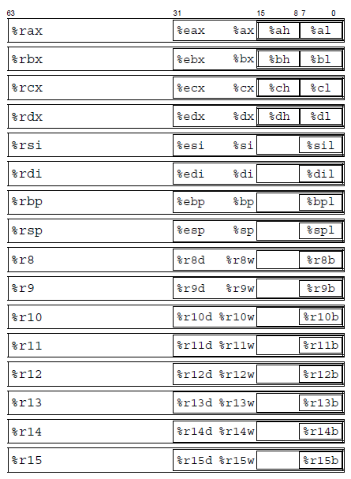
Registers
An x86-64 CPU contains a set of 16, 64 bit registers.

Slide 13
Sizes
At the end, everything is bytes…
CPU doesn’t understand “types”
It does however, know it can operate on different amounts of data
We can access sub-registers of sizes 1, 2, 4 and 8 bytes.
Therefore, CPU instructions operate on the following sizes:
b = Byte = 8b
w = Word = 16b
l = Double word = 32b
q = Quad word = 64b

Slide 14
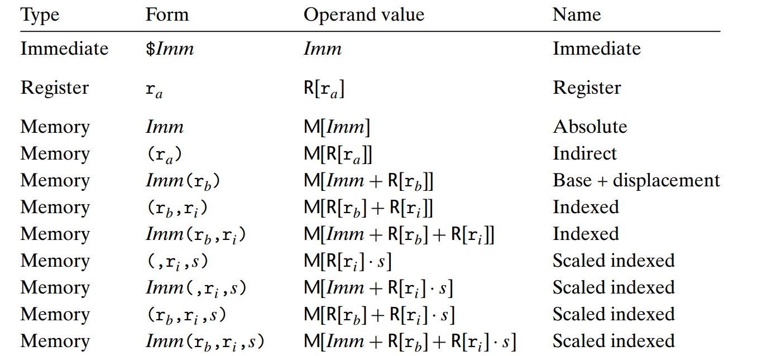
Addressing modes
An addressing mode is an expression that calculates an address in memory.
Used in many instructions.

Slide 15
Addressing modes example
movl $1, 0x604892 # address is constant value (RAM[0x604892] = 1)
movl $1, (%rax) # address is in register %rax (RAM[%rax] = 1)
movl $1, -24(%rbx) # address = -24 + %rbx (RAM[%rbx - 24] = 1)
movl $1, 8(%rax, %rdi, 4) # address = 8 + %rax + %rdi * 4 (RAM[8 + %rax + %rdi * 4] = 1)
movl $1, (%rax, %rcx, 8) # address = %rax + %rcx * 8
movl $1, 0x8(, %rdx, 4) # address = 8 + %rdx * 4
movl $1, 0x4(%rax, %rcx) # address = 4 + %rax + %rcx

Slide 16
Common Instructions
Many instructions have letter suffixes
b, w, l or q
indicates bitwidth of the operation
Example: “movl” instruction we saw.
Suffixes are dropped when the operand bitwidth is clear from operands.
“mov %rax, %rbx” obviously refers to “movq”
Instructions may feature two suffixes: the first for the source, the second for the destination.
“movzbl” moves a 1-byte source value to a 4-byte destination.

Slide 17
Common Instructions- Cont
When the destination is a sub-register, only those specific bytes in the sub-register are written.
One broad exception: a 32-bit instruction zeroes the high order 32 bits of the destination register.
For example, “mov %ebx, %ebx” might seem pointless.
In fact, this instruction zeros out the higher 32 bits of the %rbx register

Slide 18
Mov
copies value from source to destination
Source can be immediate value, register, or memory location
Destination is either a register or a memory location
At most one of source or destination can be memory.
Suffix indicates how many bytes are copied.
Memory location are passed using addressing modes.
mov $0, %eax # %eax = 0
movb %al, 0x409892 # write to address 0x409892 low-byte of %eax
mov 8(%rsp), %eax # %eax = value read from address %rsp + 8

Slide 19
Mov - Cont.
movs and movz instructions are used to specify how to fill the additional bytes, when the move is copying a smaller bitwidth to a larger.
movsbl %al, %edx # copy 1-byte %al, sign-extend into 4-byte %edx
movzbl %al, %edx # copy 1-byte %al, zero-extend into 4-byte %edx
Acceptable variants
movsbw, movsbl, movsbq, movswl, movswq, movslq
movzbw, movzbl, movzbq, movzwl, movzwq
Note: there isn’t a movzlq instruction
movl will zero the upper 32bits of the destination by default

Slide 20
Lea
Load Effective Address
Source is memory location (using an addressing mode)
Copies calculated source address to destination
Does not dereference the source address
Simply calculates a linear combination
lea 0x20(%rsp), %rdi # %rdi = %rsp + 0x20 (no dereference!)
lea (%rdi,%rdx,1), %rax # %rax = %rdi + %rdx
lea (%rdi,%rdi,8), %rdi # %rdi *= 9

Slide 21
Arithmetic Operations
add src, dst # dst += src
sub src, dst # dst -= src
imul src, dst / mul src, dst # dst *= src (signed vs. unsigned)
idiv src, dst / div src, dst # dst /= src (signed vs. unsigned)
neg dst # dst = -dst (arithmetic inverse)
and src, dst # dst &= src
or src, dst # dst |= src
xor src, dst # dst ^= src
not dst # dst = ~dst (bitwise inverse)

Slide 22
Arithmetic Operations - Cont.
shl count, dst # dst <<= count (logical left shift dst by count positions)
shr count, dst # dst >>= count (logical right shift dst by count positions)
sal count, dst # dst <<= count (arithmetic left shift dst by count positions)
sar count, dst # dst >>= count (arithmetic right shift dst by count positions)
Some instructions have variations with different operand counts.
shl dst # dst <<= 1 (no count -> assumes 1, same for sar,sal,shr)
imul src # assumes other operand in %rax

Slide 23
Branches
%eflags register stores a set of boolean flags called condition codes
Most arithmetic operations update them
conditional jump checks codes to determine whether to brench
Usually, we’ll execute a cmp/test operation to set the flags
Following up with a conditional jump
cmpl op2, op1 # computes op1 - op2, discards result, sets condition codes
test op2, op1 # computes = op1 & op2, discards result, sets condition codes

Slide 24
Branches - Cont.
Labels are names we can define in our program
During assembly, the label gets resolved as an absolute address or as an offset, depends on context
Jump operations receive as an operand some target label
The syntax will usually be “jmpX target” where X is the suffix of the mnemonic
Determines what condition to check
We can also use Indirect jumps, to jump to an address stored in a register / an addressing mode
“jmpX* %register”
“jmpX* mem”

Slide 25
Branches - Cont.
jmp target # unconditional jump
je target # jump equal (ZF=1)
jne target # jump not equal (ZF=0)
js target # jump signed (SF=1)
jns target # jump not signed (SF=0)
jg target # jump greater than (ZF=0 and SF=OF)
jge target # jump greater or equal (SF=OF)
jl target # jump less than (SF!=OF)
jle target # jump less or equal (ZF=1 or SF!=OF)

Slide 26
Branches - Cont.
ja target # jump above (CF=0 and ZF=0)
jae target # jump above or equal (CF=0)
jb target # jump below (CF=1)
jbe target # jump below or equal (CF=1 or ZF=1)
Example: cmpb b, a
If there is no overflow and a≥b (a=3,b=-2) → SF=0, OF=0
If there is no overflow and a<b (a=-1,b=4) → SF=1, OF=0
If there is a negative overflow and a>b (a=127,b=-1) → SF=1, OF=1
If there is a positive overflow and a<b (a=-128,b=1) → SF=0, OF=1

Slide 27
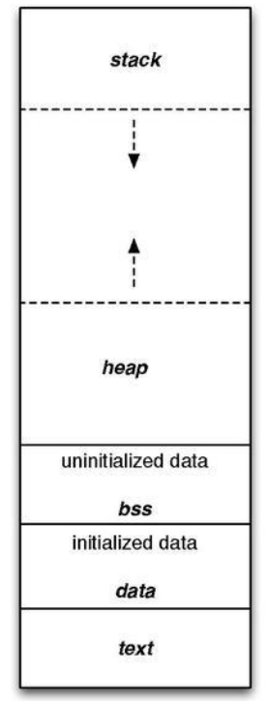
Program Structure

Slide 28
What now?
We’ve seen how to redirect control flow using jumps
But what about functions?
We know (more or less) the general idea of how local variables and function frames work, from Intro to CS.
For now though, let’s think of it as a black box.

Slide 29
Function Calling Conventions
To set up for a call, the caller puts the first six arguments into registers
%rdi, %rsi, %rdx, %rcx, %r8, %r9
What if there are more than six arguments?
We’ll talk about it next time.
Return value is passed by %rax

Slide 30
Code Example

